Slide 1
How to Apply for SDMC Enrollment
New Students
2014 – 2015 season

Slide 2
What does “application” mean?
There is no entrance exam, no specific set of academic benchmarks, and certainly no demographic criteria.
There is no application fee.
Our aim is to make an honest and diligent attempt to understand each student’s prospects for future success as a unique, positively engaged and productive math circle student.
There is no formula for this and no guarantee that we will be correct in every case. We do our best by affording applicants the flexibility to tell us their own stories through the SDMC Student Profile.
Unfortunately, we are space-limited and cannot accept all applicants. We hope that if we are not able to include you as regular members at this time, that we may still be able to be of some assistance to you.

Slide 3
Our Process
In short, the SDMC application process consists of:
  a starting message from you requesting the initiation of an application,
  some family time compiling and inputting information,
  a finishing message from you requesting a final review,
  and a decision from SDMC.

Slide 4
GoogleDocs
We use GoogleDocs to develop and maintain membership-related documents.
GoogleDocs is a free document-sharing facility that permits flexible access to and editing of documents within defined groups of collaborators.
Though SDMC maintains many such documents (because there are many students) each document is shared with each student’s own family privately.

Slide 5
What documents are involved?
Liability Waiver: preferably submitted as an email attachment, if possible; otherwise by US Mail.
Student Headshot Photo: a modest-sized headshot submitted as an email attachment.
Student Profile: created and edited on GoogleDocs and maintained by the family – this is the heart of the process.

Slide 6
The “Primary Email”
The primary email address is the “anchor” for student records and communication with the family.
The primary email must be a “live” actively-used PARENT email address.
This is in part to comply with the Children’s Online Privacy Protection Act (COPPA).
This is the default address used for parent copies of all routine SDMC messages.
This is also the default GoogleDocs share address for membership-related documents.

Slide 7
The Liability Waiver
The standard liability waiver, signed by both parent and student, is a legal document required of all students.
This is not a formality, but is required by UCSD as a condition for SDMC students to be present on the UCSD campus; we are picky about this as part of our compliance with the university’s expectations.
The particular composition of this waiver is dictated by UCSD.
Your application will not be reviewed until an acceptably complete and clear liability waiver has been received.

Slide 8
Liability Waiver (cont.)
The Liability Waiver should be submitted as a hi-res PDF scan sent by email attachment.
If the form is not complete and clearly legible, with hand-penned and dated signatures, we will ask you to resubmit.
DO NOT use cursive fonts in lieu of original signatures by hand.
Do not FAX.
Avoid cameras, especially cell phones; the results tend to be inferior.
If you cannot obtain a hi-res PDF scan, please submit the completed paper form with original signatures by US Mail; we will then scan it ourselves.

Slide 9
Liability Waiver (cont.)
The liability waiver can be downloaded from
Click here to access the waiver form
If submitted as a hi-res PDF scan, the waiver can be submitted at any time as an attachment to a message to
docs@sdmathcircle.org
If submitted as an original paper document, send it to
San Diego Math Circle
PO Box 500091
San Diego, CA 92150-0091

Slide 10
Prepare Your GoogleDocs Access
Before taking any of the steps that follow, be sure that you have established GoogleDocs access for the Primary Email Address.
If the parent wishes to share document access with the student, be sure that you have also prepared GoogleDocs access for the student email address.
Go to docs.google.com, click “Sign up”.
A Gmail account is not necessary.

Slide 11
Step 1 – Send Application Request
Student’s parent should send a message essentially as follows:
From: Primary Email Address
To: docs@sdmathcircle.org
Subject: “application” or “registration”
Attached: Smith, John Liability Waiver.pdf
↑ ↑ ↑ ↑ ↑ ↑ ↑ ↑ ↑ ↑ ↑ ↑ ↑ ↑ ↑
The message body should request the generation of a Student Profile. Please include the student name and home phone for possible contact in case any problems are encountered.
If the parent wishes to share access to the Student Profile with the student, provide the student’s email address at this time in the same message.
Always name files with student name as
“Last, First”

Slide 12
Step 2 – Receive Profile Link
An empty Student Profile will be created on GoogleDocs and shared with the parent using the primary email address.
If the parent chooses, the Student Profile will also be shared with the student.
Each share address will receive an automated message from GoogleDocs containing a link to the Student Profile.

Slide 13
Step 3 – Develop Student Profile
Access the Student Profile on GoogleDocs and fill in information as appropriate.
Don’t attempt to download and re-upload the document – it can be edited directly on GoogleDocs through your browser. If you encounter rendering issues, it is likely your browser – check settings or try another; we are not equipped to troubleshoot.
You do not need to do this all at once! In fact, we want you to take your time and be thoughtful. GoogleDocs saves automatically, permitting you to walk away and return easily.
Member students are expected to keep their Student Profiles up to date on an ongoing basis.

Slide 14
Student Profile – Upper Part
The upper part of the Student Profile is concerned with administrativia such as student and family contact information, ability group selection, parent service interests, financial pledging, etc.
Several checkboxes direct you to information on safety, SDMC’s privacy policy, and code of conduct.
This is information SDMC needs to function and we need your cooperation in providing the information requested; please do not skip any of these sections.

Slide 15
Student Profile – Lower Part
The lower part of the Student Profile is concerned with student educational background.
SDMC students tend to be diverse in their activities and accomplishments. Accordingly, the Student Profile has been designed to be broad and flexible. This also makes it long, but don’t be daunted – nobody does everything.
The Student Profile contains numerous expandable text boxes that allow personalization with additional information or explanations.
This is particularly significant for families of younger students who will not have substantial academic records in the more formal sense.

Slide 16
Student Headshot Photo
Please select a modest-sized headshot or head-and-shoulders shot to submit along with your application – think yearbook or passport style.
This should have a portrait/vertical layout (taller than wide) in a standard photo format (JPG, GIF, PNG) and should be at least 640x480 pixels, but need not be much larger.
Please do not use landscape/horizontal layouts (wider than tall) or document formats (PDF, DOC, etc.).
Cell phone “selfies” can be ok if well-focused, well-lit, and consistent with the above directions. Webcam photos are undesirable in several ways.
We ask for photos to assist us and our volunteers in connecting names and faces as they lend support to our activities. They are not intended for release to the public.
Please submit this photo as an attachment to your application review request.

Slide 17

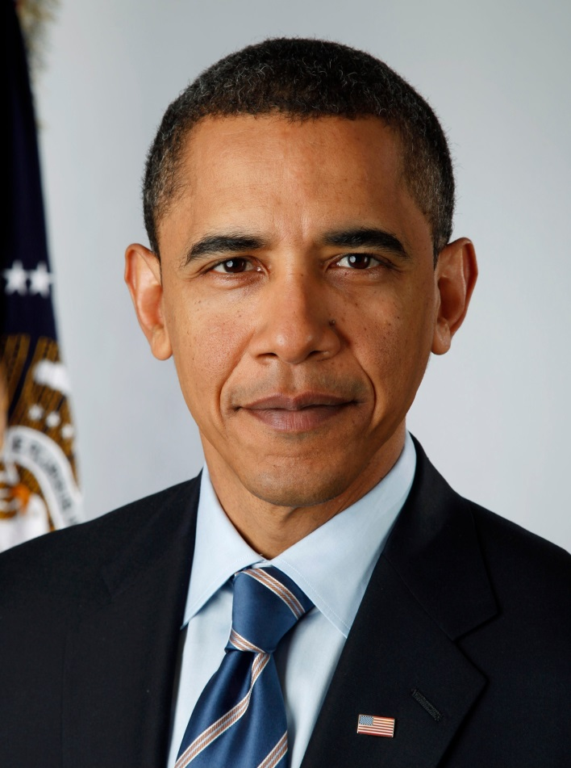
Good Headshot Examples
Good
Good

Slide 18
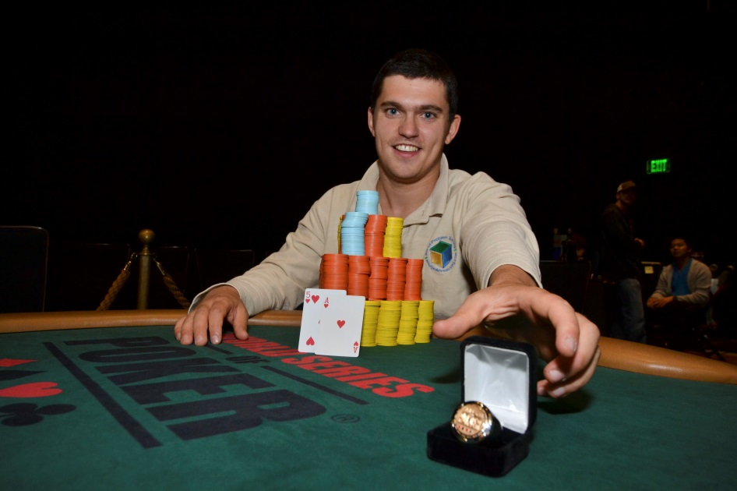
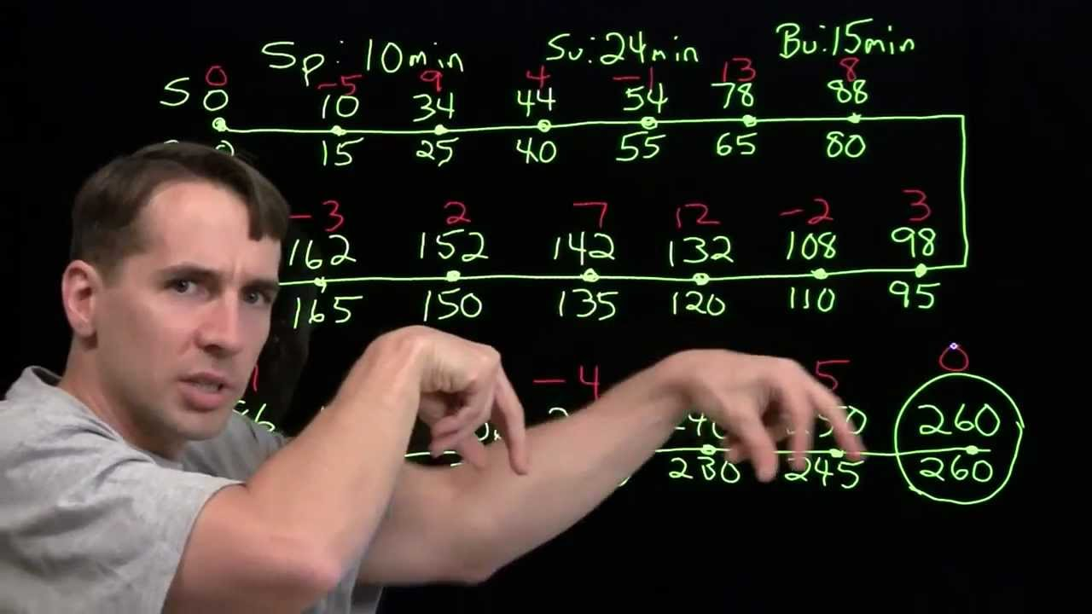
Cool, but not so good …
Richard is awesome, but this photo is all wrong for us.
Nice picture of Valentin, but doesn’t work for our needs.

Slide 19
Step 4 – Submit Request for Review
When you are satisfied with the condition of your Student Profile, submit a message as follows:
From: Primary Email Address
To: docs@sdmathcircle.org
Subject: Application Review Request
Attached: Smith, John Photo.jpg
↑ ↑ ↑ ↑ ↑ ↑ ↑ ↑ ↑ ↑ ↑
The message body should state that the Student Profile is ready for review and student photo should be attached. Please include the student name and home phone for possible contact in case any problems are encountered.
Always name files with student name as
“Last, First”

Slide 20
Step 5 – Receive Decision
As a merit-based process, decisions often are not immediate and are not made on a “first-in, first accepted” basis. Certainly, those who apply earlier will be reviewed earlier, but admissions decisions will be made in a rolling manner as clarity develops on the whole set of applications throughout the application period.
We will fully consider any application received during the month of August. Some early decisions may be made in August, but the majority of decisions should be expected in early half of September.
Applications received after the end of August will be considered to the extent we have remaining space.
Applications will be “Accepted”, “Declined”, or “Deferred”.

Slide 21
If Accepted
You will receive a message clearly indicating acceptance, including confirmation of your ability group and your SDMC ID Code
Your SDMC ID Code will also be entered into your Student Profile for reference.
If you have not received such a clear message and you do not see your unique SDMC ID Code entered in your Student Profile, you have not (yet) been accepted.

Slide 22
If Deferred
Deferral essentially means that a student’s application has our interest, but capacity limitations compel us to “wait list” the student.
The Student Profile will be retained on GoogleDocs at least until the next SDMC season.
This will permit you to provide additional information if you wish and can be the beginning basis of a possible reapplication the next season.
There is no specific plan for revisiting the “wait list”. During our first years of this admissions process, no deferred students have been added in the course of the season.

